Slide 1
Chapter 8 – Time series
Artificial Intelligence

Slide 2
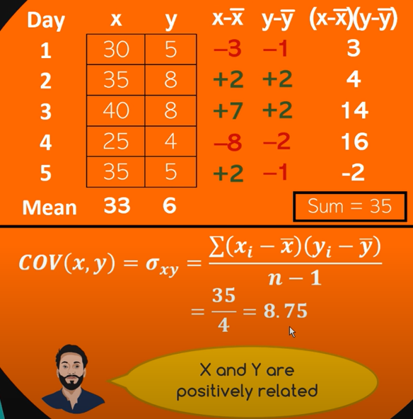
Non-time-series data
We have days and record temperature and ice cream sales per day
The dataset has one average for temperature and one for sales
These numbers wouldn’t change if we moved the days around
Swap day 2 and 4

Slide 3
Time series data
Definition: Time series data is a sequence of data points collected or recorded at specific time intervals.
The time component is critical: the data points are ordered chronologically.
Observations at different time points often exhibit dependencies. Future values can depend on past ones (depicting trends and seasonality).
Time intervals can be regular (hourly, daily, monthly) or irregular, depending on the domain (e.g., stock prices vs. event-driven data).
A time series can be univariate (one variable measured over time) or multivariate (multiple variables measured simultaneously).
Applications: Forecasting (sales, stock prices), anomaly detection (in industrial equipment), and pattern recognition (speech, ECG data).

Slide 4
Trends in time series data
A trend is a long-term increase or decrease in the data over time, reflecting an underlying direction in the data.
There are the trends we also see in ‘normal’ data:
Upward, downward, linear or exponential, logarithmic (= reverse exponential)
In ‘normal’ data this required two variables, now only one
But there are also time-series specific types of trends:
Seasonal

Slide 5
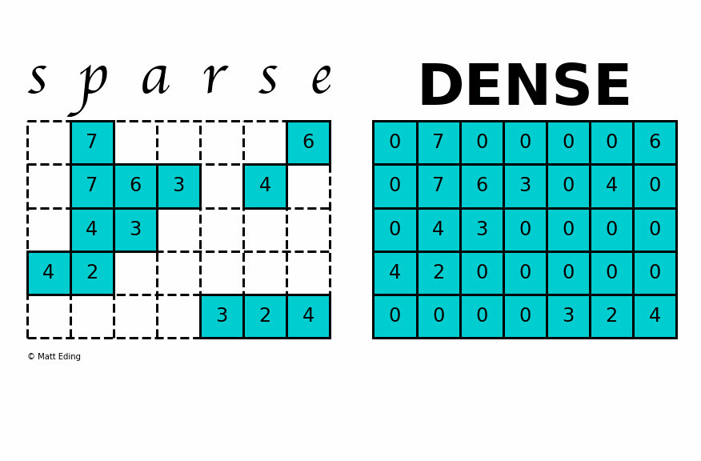
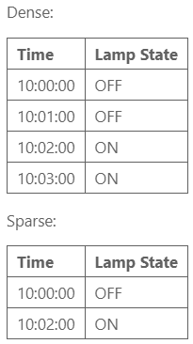
Sparse vs dense datasets
Irregular intervals.
Gaps between events.
How frequently and consistently data points are recorded?
A dense dataset has a value for every time step in the series — even if nothing changed.
Regular intervals: Data is recorded consistently (every minute, every hour)
No missing timestamps.
A sparse dataset only includes entries when something happens
Irregular intervals
Gaps between events

Slide 6
Sparse vs dense datasets
Use Dense Datasets when:
You have high-frequency data without much sparsity.
You need simpler calculations and visualizations.
Memory is not a constraint.
Use Sparse Datasets when:
Your data has many zeros or missing values (e.g., binary indicators, intermittent signals).
You’re working with event-driven or irregularly changing data.
Memory efficiency is essential due to dataset size.
For applications where you need both memory efficiency and the continuity of dense datasets (like with rolling windows on sparse data), it’s often helpful to start with sparse data and convert it to dense format only for specific analyses.

Slide 7
Why It Matters
Dense data is easier to work with for things like rolling averages, resampling, and plotting
Sparse data is more compact and efficient when recording only changes or events (common in logs or event-driven systems)
To perform most time-series analysis, sparse datasets are typically converted to dense format
Using techniques like .resample() and .ffill() in pandas

Slide 8

Stationarity in time series
A stationary time series is one whose statistical properties (like mean, variance, autocorrelation) are constant over time.
No trend or seasonality
The series "looks the same" at any point in time
It's easier to model and predict because the behavior is consistent
The mean stays around 10
No trend (not increasing or decreasing over time)
Variance is stable

Slide 9


Stability (in control systems or broader dynamics)
Stability usually refers to whether a system returns to equilibrium after a disturbance.
In a stable system, values stay bounded or return to a steady state
This means a process that doesn’t explode or spiral out of control
Unstable:
Stable (but not stationary):

Slide 10
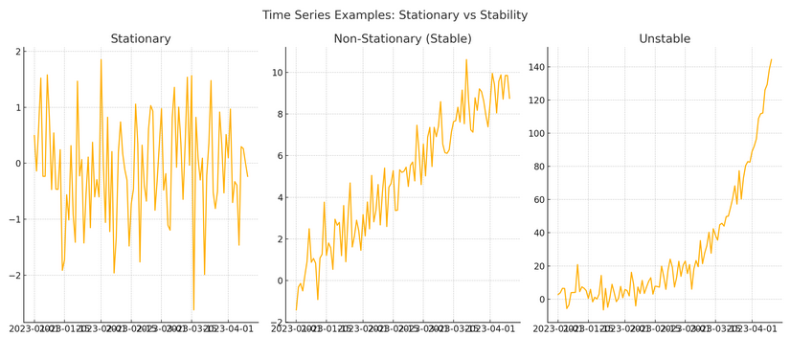
Stability and stationarity
Stationary: Data revolves around a center point
Stable (non stationary): Has an upward trend (mean and variance change over time)
Non-stable: data grows exponentially with increasing variance

Slide 11
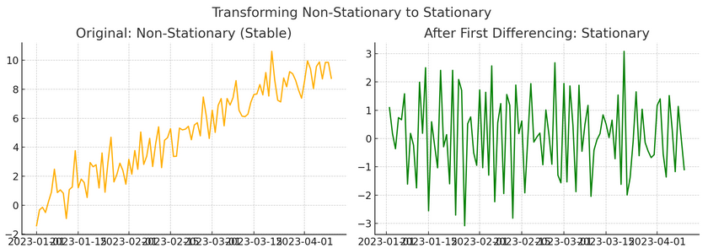
Stability and stationarity
If you apply a first-order differencing to a non-stationary dataset it becomes stationary
Constant mean with constant variance
This makes is suitable for many time series models like ARIMA

Slide 12


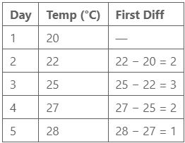

First order differencing
You deduct the previous datapoint from every datapoint
Example:
Why Use It?
Removes trend, making data more stable over time
Many models like ARIMA assume stationary input
Makes it easier to identify seasonality or cycles

Slide 13
Why Use It?
Removes trend, making data more stable over time
Many models like ARIMA assume stationary input
Makes it easier to identify seasonality or cycles

